Slide 1
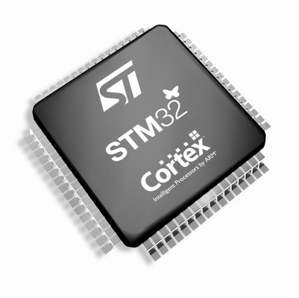
The Cortex-M3/M4 Embedded Systems: The Cortex-M3/M4 Processor Basics
Refer to Chapter 1, 3, and 4 in the reference book
“The Definitive Guide to ARM Cortex-M3 and Cortex-M4 Processors”

Slide 2
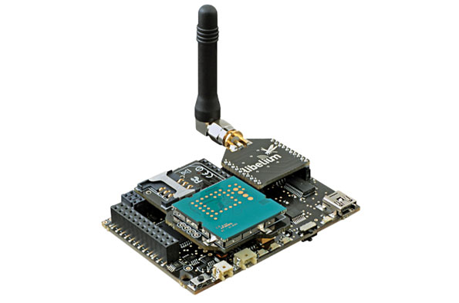
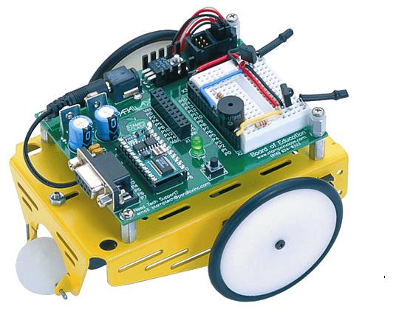
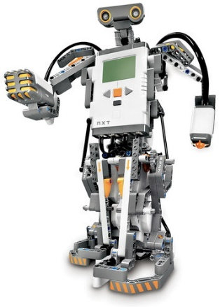
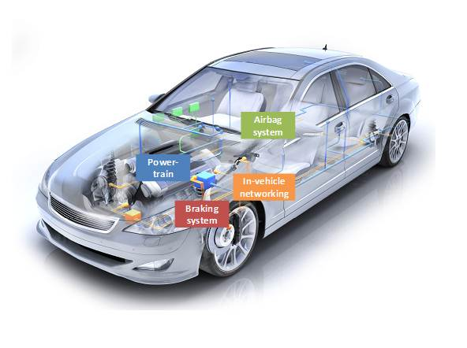


Embedded System?
An embedded system is a computer system designed to perform one or a few dedicated functions often with constraints, e.g., in real time, with low power or limited memory, …
Embedded systems
A few dedicated functions
Under constrained conditions
General-purpose computers
Flexible to meet a wide range of end-user needs
No such rigid constraints

Slide 3
Processers in Embedded Systems
Embedded processors can be broken into two broad categories: ordinary microprocessors (μP) and microcontrollers (μC).
A fairly large number of basic CPU architectures are used.
Von Neumann as well as Harvard architectures
RISC as well as non-RISC
Word lengths vary from 4 bits to 64 bits and beyond (mainly in DSP processors).
Most architectures come in a large number of different variants and shapes.

Slide 4


History about ARM Processers
ARM company is known as the Advanced RISC Machine, born in 1990
ARM does not manufacture processors or sell chips directly. They license their processor design to semiconductor companies, known as intellectual property (IP) licensing.
Make over 2 billion ARM processors being shipped each year possible
As of 2009, ARM processors account for approximately 90% of all embedded 32-bit RISC processors

Slide 5
History about ARM Processers
ARM instructions are 32-bit
Thumb instructions are 16-bit
Thumb-2 instructions are 32-bit

Slide 6
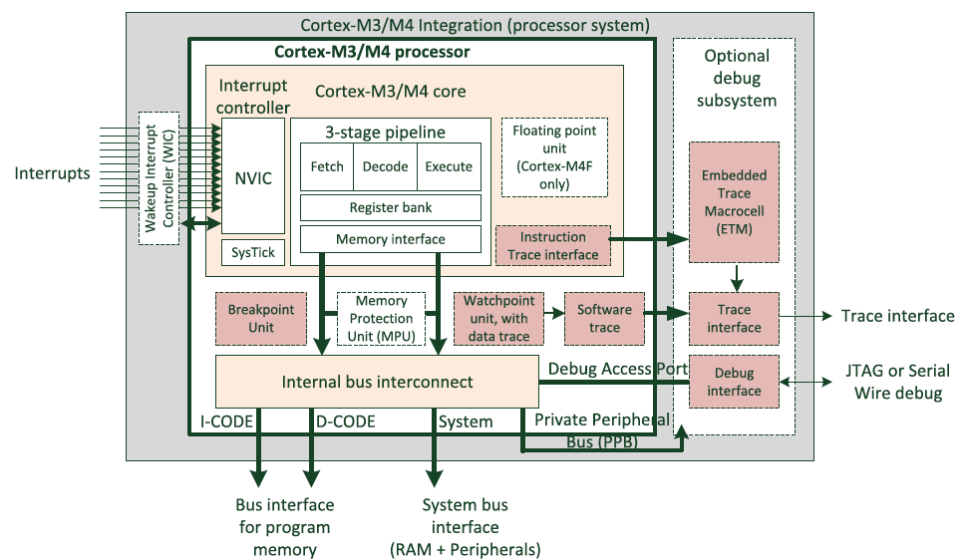
Overview of Cortex-M3/M4 processor

Slide 7
Overview of Cortex-M3/M4 processor
32-bit microprocessor: 32-bit data path, 32-bit registers, 32-bit memory interfaces.
Harvard architecture: separate instruction bus and data bus, which allows instructions and data accesses to take place at the same time.
4GB Memory space
Registers: Registers (R0 to R15) and special registers.
Two operation modes: thread mode and handler mode
Two access levels: privileged level and user level.
Interrupts and Exceptions: a built-in Nested Vectored Interrupt Controller, supporting 11 system exceptions plus 240 external IRQs.

Slide 8
Overview of Cortex-M3/M4 processor
MPU: an optional Memory Protection Unit allows access rules to be set up for privileged access and user program access.
The Instruction Set: Thumb-2 instruction set allows 32-bit instructions and 16-bit instructions to be used together; no ARM instructions allowed
Fixed internal debugging components: provide debugging operation supports and features such as breakpoints, single step.
M4 has extra features: the DSP extensions and the optional single precision floating point unit

Slide 9
Features of Cortex-M3/M4 Processors
Greater performance efficiency, allowing more work to be done without increasing the frequency or power requirements
Low power consumption, enabling longer battery life
Enhanced determinism, guaranteeing that critical tasks and interrupts are serviced in a known number of cycles
Improved code density, ensuring that code fits in even the smallest memory
Ease of use, providing easier programmability and debugging
Lower-cost solutions, reducing 32-bit-based system costs at less than US$1 for the first time
Wide choice of development tools, from low-cost or free compilers to full-featured development suites

Slide 10
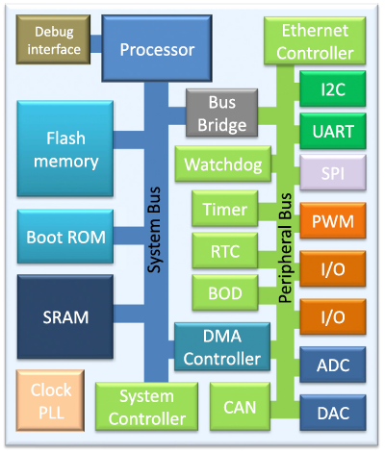
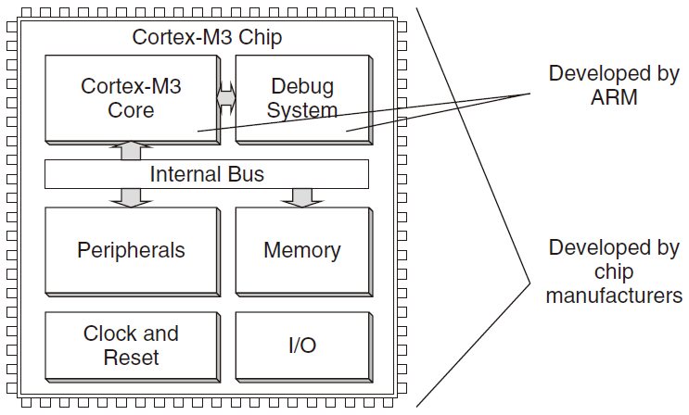
Cortex-M3/M4 Processors vs MCUs
The Cortex-M3/M4 processor is the central processing unit (CPU) of a microcontroller chip
After chip manufacturers license the Cortex-M3/M4 processor, they can put the Cortex-M3/M4 processor in their silicon designs, adding memory, peripherals, input/output (I/O), and other features.
Cortex-M3/M4 processor based chips from different manufacturers will have different memory sizes, types, peripherals, and features

Slide 11
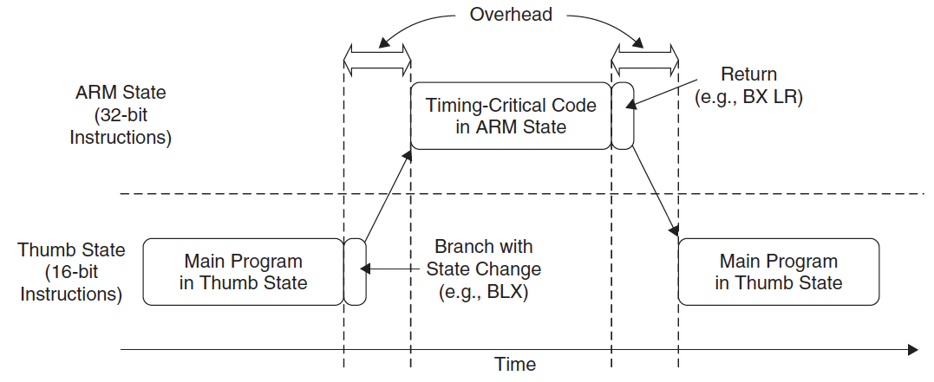
ARM Processors: Instruction State Switches
In the ARM state, the instructions are 32-bit and can execute all supported instructions with very high performance
In the Thumb state, the instructions are 16-bit, so there is a much higher instruction code density
Can we combine them to achieve the best of both worlds?
Any cost?
overhead of state switches
complex software development
Notes:
the ARM instructions that are 32-bit and Thumb instructions that are 16-bit. During
program execution, the processor can be dynamically switched between the ARM state or
the Thumb state to use either one of the instruction sets. The Thumb instruction set provides
only a subset of the ARM instructions, but it can provide higher code density. It is useful for
products with tight memory requirements.
In 2003, ARM announced the Thumb-2 instruction set, which is a new superset of Thumb instructions that
contains both 16-bit and 32-bit instructions.

Slide 12
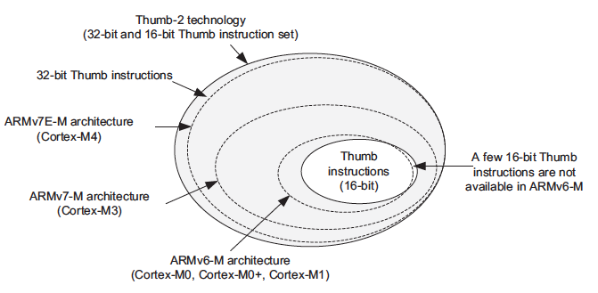
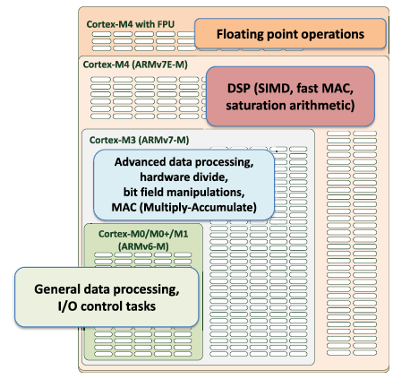
Instruction Set of Cortex-M3/M4
Cortex-M3/M4 supports only the Thumb-2 (including the traditional Thumb) instruction set
Advantages:
No state switching overhead, saving both execution time and instruction space
No need to separate ARM code and Thumb code source files, making software development and maintenance easier
Notes:
the ARM instructions that are 32-bit and Thumb instructions that are 16-bit. During
program execution, the processor can be dynamically switched between the ARM state or
the Thumb state to use either one of the instruction sets. The Thumb instruction set provides
only a subset of the ARM instructions, but it can provide higher code density. It is useful for
products with tight memory requirements.
In 2003, ARM announced the Thumb-2 instruction set, which is a new superset of Thumb instructions that
contains both 16-bit and 32-bit instructions.

Slide 13
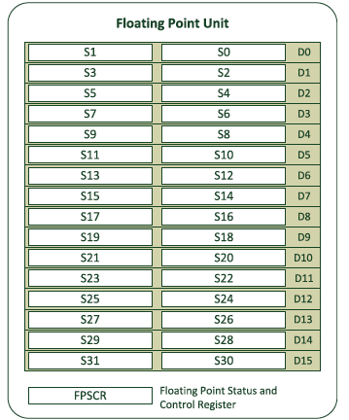
Cortex-M3/M4 Basics: Registers
Cortex-M4 processor only

Slide 14
Cortex-M3 Basics: Registers
General-Purpose Registers
R0~R7 (low registers)
Can be accessed by all 16-bit Thumb instructions and all 32-bit Thumb-2 instructions
reset value is unpredictable
R8~R12 (high registers)
Accessible by all Thumb-2 instructions but not by all 16-bit Thumb instructions
reset value is unpredictable
Stack Pointer R13
Two stack pointers are banked so that only one is visible at a time.
Main Stack Pointer (MSP) : This is the default stack pointer, used by the OS kernel, exception handlers, and privileged-mode programs
Process Stack Pointer (PSP) : Used by the user application code

Slide 15
Stack and Its Pointer
Stack: a first-in last-out buffer
The stack pointers are used for accessing stack memory with PUSH and POP
For example, to store register contents to stack memory at the start of a subroutine and then restore the registers from stack at the end of the subroutine.

Slide 16
Stack in Cortex-M3
Cortex-M3 uses a full-descending stack arrangement
The stack pointer decrements when new data is pushed in the stack
The assembly language syntax is as follows:
PUSH {R0} ; R13=R13-4, then Memory[R13]=R0
POP {R0} ; R0=Memory[R13], then R13=R13+4
Either R13 or SP can be used in your program codes (referring to the current stack pointer you are using, either MSP or PSP)
A particular stack pointer (MSP/PSP) can be accessed using special register access instructions (MRS/MSR)
Since PUSH and POP operations are always word aligned, the stack pointer R13 bit 0 and bit 1 are hardwired to zero and always read as zero (RAZ)

Slide 17
Cortex-M3: Stack Memory Operations
Multiple registers can be pushed and popped in one instruction, using comma to separate
PUSH {reglist}
POP {reglist}
If a POP instruction includes PC in its reglist, a branch to this location is performed when the POP instruction has completed.
Note that Bit[0] of the value used to set the PC must be 1 (used to update the APSR T-bit)
Example:
PUSH {R0-R7, LR} ; Save registers
…
POP {R0-R7, PC} ; Restore registers
;push the largest numbered register first
; pop the lowest numbered registers first

Slide 18
Cortex-M3: Stack Implementation
The stack pointer (SP) points to the last data pushed to the stack memory, and the SP decrements first in a new PUSH operation.
For POP operations, the data is read from the memory location pointed by SP, then the stack pointer is incremented. The contents in the memory location are unchanged.

Slide 19
Cortex-M3 Basics: Registers
Link Register R14
R14 is the link register (LR), used to store the return program counter when a subroutine or function is called.
e.g., when using the BL (Branch with Link) instruction:

Slide 20
Cortex-M3 Basics: Registers
Program Counter R15
When you read this register you will find that the value is different than the location of the executing instruction by 4, due to the pipelining of the processor
Example:
0x1000 : MOV R0, PC ; R0 = 0x1004
When reading the PC, the LSB (bit 0) is always 0.
Why?
When writing to the PC, it will cause a branch. The LSB must be set to 1 to indicate the Thumb state operations (setting to 0 implies to switch to the ARM state, which will result in a fault exception in Cortex-M3)
Can you write to the PC in 8086? Why do we need to set LSB of R15 (true for R14) since all instructions are half-word or word aligned?

Slide 21
Cortex-M3 Basics: Registers
Special Registers
The special registers in the Cortex-M3 processor include:
Program Status Registers (PSRs)
Interrupt Mask Registers (PRIMASK, FAULTMASK, and BASEPRI)
Control Register (CONTROL)
Can only be accessed via MSR and MRS instructions
MRS <reg>, <special_reg> ; Read special register
MSR <special_reg>, <reg> ; write to special register
Note: MSR and MRS cannot have memory addresses, only registers are allowed

Slide 22
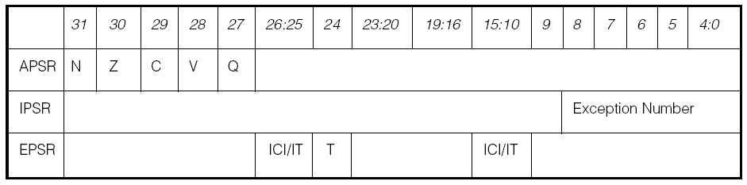
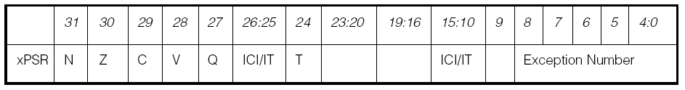
Special Registers
Program Status Registers (PSRs)
The program status registers are subdivided into three status registers:
1. Application PSR (APSR), 2. Interrupt PSR (IPSR), 3. Execution PSR (EPSR)
When they are accessed as a collective item, the name xPSR is used (PSR used in program codes).

Slide 23
EPSR and IPSR are read-only:
MRS R0, APSR ; Read Flag state into R0
MRS R0, IPSR ; Read Exception/Interrupt state
MRS R0, EPSR ; Read Execution state
MSR APSR, R0 ; Write Flag state
Accessing xPSR:
MRS R0, PSR ; Read the combined program status word
MSR PSR, R0 ; Write combined program state word

Slide 24
Bit Fields in Cortex-M3 Program Status Registers
Bit | Description
N | Negative
Z | Zero
C | Carry/borrow
V | Overflow
Q | Sticky saturation flag
ICI/IT | Interrupt-Continuable Instruction (ICI) bits, IF-THEN instruction status bit
T | Thumb state, always 1; trying to clear this bit will cause a fault exception
Exception Number | Indicates which exception the processor is handling

Slide 25
Cortex-M3 Interrupt Mask Registers
PRIMASK, FAULTMASK and BASEPRI Registers
The PRIMASK, FAULTMASK, and BASEPRI registers are used to disable exceptions.
Register Name | Description
PRIMASK | A 1-bit register. When this is set, it allows NMI and the hard fault exception; all other interrupts and exceptions are masked; default is 0 (no masking)
FAULTMASK | A 1-bit register. When this is set, it allows only the NMI, and all interrupts and fault handling exceptions are disabled; default is 0
BASEPRI | A register of up to 9 bits. It defines the masking priority level. When this is set, it disables all interrupts of the same or lower level (larger priority value); default is 0

Slide 26
To access the PRIMASK, FAULTMASK, and BASEPRI registers, the MRS and MSR instructions are used.
Example:
MRS R0, BASEPRI ; Read BASEPRI register into R0
MRS R0, PRIMASK ; Read PRIMASK register into R0
MRS R0, FAULTMASK ; Read FAULTMASK register into R0
MSR BASEPRI, R0 ; Write R0 into BASEPRI register
MSR PRIMASK, R0 ; Write R0 into PRIMASK register
MSR FAULTMASK, R0 ; Write R0 into FAULTMASK register
PRIMASK and BASEPRI are useful for temporarily disabling interrupts in timing-critical tasks; FAULTMASK is used by the OS kernel which cleans up a crashed task
The PRIMASK, FAULTMASK, and BASEPRI registers cannot be set in the user access level.

Slide 27
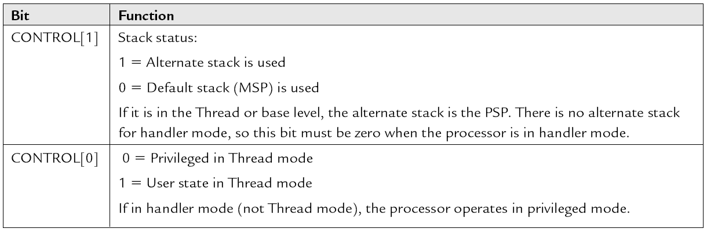
Special Registers
The Control Register
The Control register is used to define the privilege level and the stack pointer selection. This register has two bits.

Slide 28
CONTROL[1]
In Cortex-M3, the CONTROL[1] bit is always 0 (MSP) in handler mode. However, in the Thread mode, it can be either 0 or 1.
This bit is writable only when the core is in Thread mode and privileged.
CONTROL[0]
The CONTRL[0] bit is writable only in privileged level.
To access the Control register, the MRS and MSR instructions are used:
MRS R0, CONTROL ; Read CONTROL register into R0
MSR CONTROL, R0 ; Write R0 into CONTROL register

Slide 29
Cortex-M3 Basics: Operation Mode
Two modes and two privilege levels.
Operation Modes and Privilege Levels in Cortex-M3
 | Privileged Level | User Level
When running an exception | privileged Handler Mode
When running main program | privileged Thread Mode | User Thread Mode

Slide 30
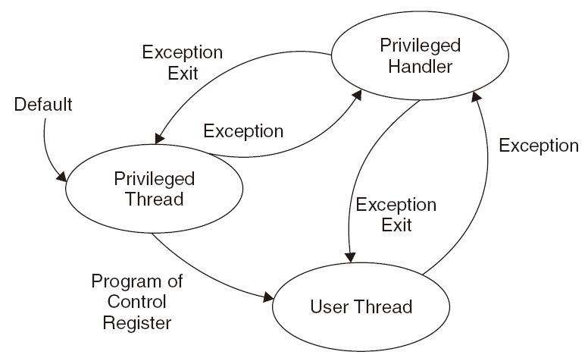
Operation Modes in Cortex-M3/M4
Two modes and two privilege levels
Notes:
In the privileged state, a program has access to all memory ranges (except when prohibited by MPU settings) and can use all supported instructions.
The separation of privilege and user levels improves system reliability by preventing system configuration registers from being accessed or changed by some untrusted programs.

Slide 31
Cortex-M3 Basics: Operation Mode
When the processor exits reset, it is in Thread mode with privileged access level
In the user access level (Thread mode), access to the System Control Space (SCS, a memory block for configuration registers and debugging components) is blocked.
In the user access level, access to special registers (except the APSR) is also blocked. Fault exception will occur when trying to access SCS or special registers
Software in a privileged access level can switch the program into the user access level by setting CONTROL[0]=1
When an exception occurs, the processor will automatically switch to privileged state and return to the previous state when exiting the exception handler
Therefore, in order to change to privileged level, a user program has to go through an exception/interrupt handler which can set the CONTROL register before returns.

Slide 32
When the CONTROL[0]=0, only the processor mode changes when an exception takes place.
Switching Processor Mode at Interrupt

Slide 33
When CONTROL[0] = 1, both processor mode and access level change when an exception takes place.
Switching Processor Mode and Privilege Level at Interrupt

Slide 34
Switching of Operation Mode by Programming the Control Register or by Exceptions

Slide 35
Cortex-M3: The Two-Stack Model
The Cortex-M3 has two stack pointers: the Main Stack Pointer (MSP) and the Process Stack Pointer (PSP).
The SP register to be used is controlled by the bit 1 of the CONTROL register.
Control [1] = 0, both Thread mode and Handler mode use MSP (main program and handlers share the same stack memory region)

Slide 36
Cortex-M3: The Two-Stack Model
Control [1] = 1, the PSP is used in Thread mode and the MSP is used in handler mode (main program and handlers have separate stack memory regions)
Which stack will the automatic stacking and unstacking mechanism use?
Notes:
This can prevent a stack error in a user application from damaging the stack used by the OS (assuming that the user application runs only in Thread mode and the OS kernel executes in handler mode).

Slide 37
Cortex-M3: Exceptions and Interrupts
The Cortex-M3 supports a fixed number of system exceptions and a number of interrupts (called IRQ), and a NMI input signal (e.g., connected to a watchdog timer or a voltage-monitoring block)

Slide 38
Cortex-M3 Basics: Vector Table
The vector table is an array of word data, with each representing the starting address of the ISR for one exception/interrupt type.
The base address of the vector table is re-locatable (set the relocation register in the NVIC); initially, the base address is 0x0.
The word stored at address 0x00000000 is used as the starting value for the MSP.
Note that the LSB of all vectors in the table must be set to 1 (indicating the exception will be executed in Thumb state)
Example:
The reset is exception type 1. The address of the reset vector is 1 times 4, which equals 0x00000004; and NMI vector (type 2) is located at 2 * 4 = 0x00000008

Slide 39
Vector Table Definition After Reset

Slide 40
Cortex-M3: Reset Sequence
After the processor exits reset, it will read two words from memory:
Address 0x00000000: default value of R13 (MSP)
Address 0x00000004: Reset vector (the starting address of startup program)

Slide 41
Initial Stack Pointer Value and Initial Program Counter (PC) Value Example
Assume that the stack memory range from 0x20007C00 to 0x20007FFF
Notes:
Notice that in the Cortex-M3, vector addresses in the vector table should have their LSB set to 1 to indicate that they are Thumb code. For that reason, the previous example has 0x101 in the reset vector, whereas the boot code starts at address 0x100.
It is necessary to have the stack pointer initialized, because some of the exceptions (such as NMI) can happen right after reset, and the stack memory could be required for the handler of those exceptions.

